Slide 1
Constructive Engagement : Context and Concept

Slide 2
Context
Poor governance is a, if not THE, principal obstacle to the achievement of poverty reduction and other critical human development goal.
Good governance – transparent, accountable, participatory, effective – cannot be achieved by governments alone.
Good governance requires strong, effective government AND the active participation of citizens and civil society organizations.

Slide 3
Why constructive engagement
Because ordinary citizens – especially women, poor people, marginalized groups – are largely excluded from governance processes that directly affect their lives
Citizens have the right and the responsibility to contribute to processes of public decision-making

Slide 4
Why Constructive Engagement
Constructive Engagement
Improved
Governance
Empowerment
Development effectiveness

Slide 5
Why Constructive Engagement
Improving governance
deepening democracy towards poverty reduction
Increased development effectiveness
Improved public service delivery
Informed policy design
Empowerment particularly of poor people
Increase and aggregate the voice of the poor to increase chance of greater responsiveness from government to their needs

Slide 6
Why Constructive Engagement
Accountability
“Right to Claim”
Transparency
“Right to Know”
Good Governance
Procedure / laws
Institutions / mechanism
Programs
Budget/ resource
Participation
“Right to Influence”

Slide 7
Definition
Constructive Engagement is the exercise of power by organized citizens towards common good.
range of processes that brings together stakeholders to act on a concern put forward by the public/ citizens in an organized fashion to produce reforms in governance for positive change.

Slide 8
Constructive Engagement
is about making democracy stronger and justice real, as well as influencing a people-oriented policy that will benefit society, especially the marginalized. It is a means and an end by itself.
Notes:
Constructive engagement is about making democracy stronger and justice real, as well as influencing a people-oriented policy that will benefit society, especially the marginalized. It is a means and an end by itself.

Slide 9
Constructive Engagement
It involves dialogue between and among stakeholders
Trust-building
Complementation / Synergy
It is not only advocating for social accountability from government but also working with government to implement development programs

Slide 10
Constructive Engagement
uses different strategies ranging from collaboration to confrontation.
CSOs need to think about how to disengage from one strategy to the next, as they adapt to the situation.

Slide 11
Four Pillars of Effective Constructive Engagement

Slide 12
Factors Affecting Constructive Engagement
the kind of government CSOs are dealing with
the power/capacity of the citizens in doing constructive engagement
“At the heart of participatory governance : citizen empowerment and active citizenship”

Slide 13
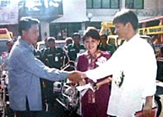
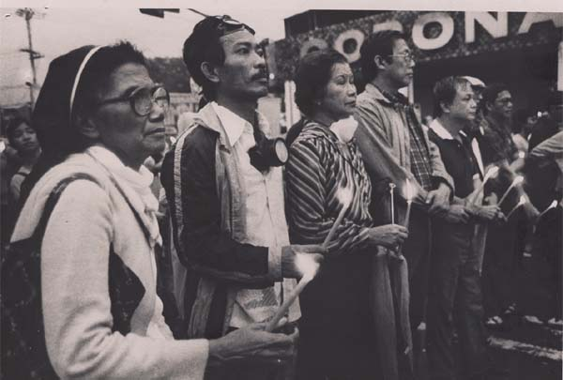
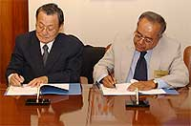
Constructive Engagement: What It Is
Citizen groups and government
Evidence- or information-based
Results- or solutions-oriented
Sustained and sustainable engagement

Slide 14
Constructive Engagement: What It Is Not
Destroying institutions
Unilateral
Co-optation
Confrontation for confrontation’s sake

Slide 15
Role of CSO in Constructive Engagement
Proponent for change
Partners for reform
Voice of the citizen
Fiscalizer to stop corruption

Slide 16
Role of CSOs in Constructive Engagement
Role of CSO | How it is done | Example / Tools used
Partners for Reforms | Cooperate in implementing specific reform government program as partner Participation in permanent mechanism for governance | Forest Conservation and protection Technical Working Group; Local Special bodies; Bottoms-up Planning and budgetting (BUPB)
Proponent of Change / Model Builder | Own initiative of CSOs to implement development projects | Micro-financing Farmer-field School Community-based health center, day care, etc
Fiscalizers to stop corruption | Monitoring performance of elected officials, government agencies, development programs and project | Score Card ; Shadow report budget watch; Book watch, “Road Watch”
Voice of the People | Advocacy work Participation in consultations, public debates | Public forum / awareness raising / campaign; signature campaign; mass action, etc

