Slide 1
The Technical Assistance Component of the Integrated Agricultural
Productivity Project (IAPP)
CSO consultation meeting
04 April 2013

Slide 2
Overview of IAPP TA
Global Agriculture and Food Security Programme Grant of USD 50 million received in 2010 for the IAPP
Objective of the IAPP - to sustainably enhance productivity of agriculture (crop, livestock and fisheries) in two agro-ecologically constrained and economically depressed areas --Rangpur and Barisal.

Slide 3
IAPP Components
1. Technology Generation
(research: BARI, BRRI, SCA, BFRI)
2. Technology adoption
(extension: DAE, DoF & DLS)
3. Irrigation and Water Management
(BADC)
4. Technical Assistance for Capacity Development
Investment components implemented by GoB & supervised by WB
TA component implemented and supervised by FAO

Slide 4
Technical Assistance for Capacity Development
Capacity development for more effective, inclusive and country-owned agriculture, food security and nutrition investment programmes – this goes beyond the IAPP
What is investment programming?
  Planning, coordination and delivery of investment projects in agriculture and food and nutrition security
  Examples of investment projects:
    Infrastructure development
    Irrigation rehabilitation
    Agricultural research
    Agricultural extension
    Institution development
    Nutrition education
Notes:
The need to develop operational capacities to design and implement investment operations in the context of increased financial resources in support of agriculture, food security and nutrition.

Slide 5
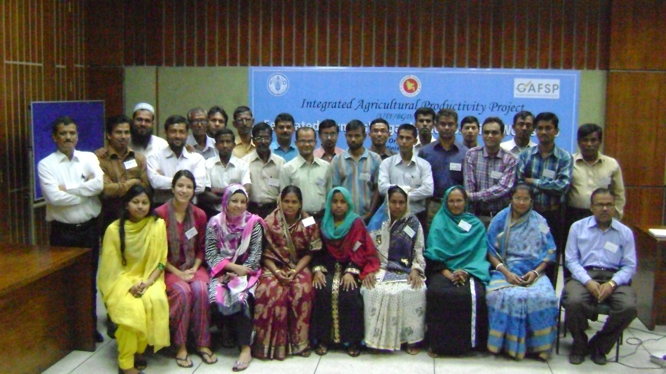
Capacity Development of Different Groups Under the IAPP TA
Non-state actors, including farmer organizations
IAPP project implementation staff
GoB staff including Ministry of Agriculture; Ministry of Fisheries and Livestock; Ministry of Food and Disaster Management.

Slide 6
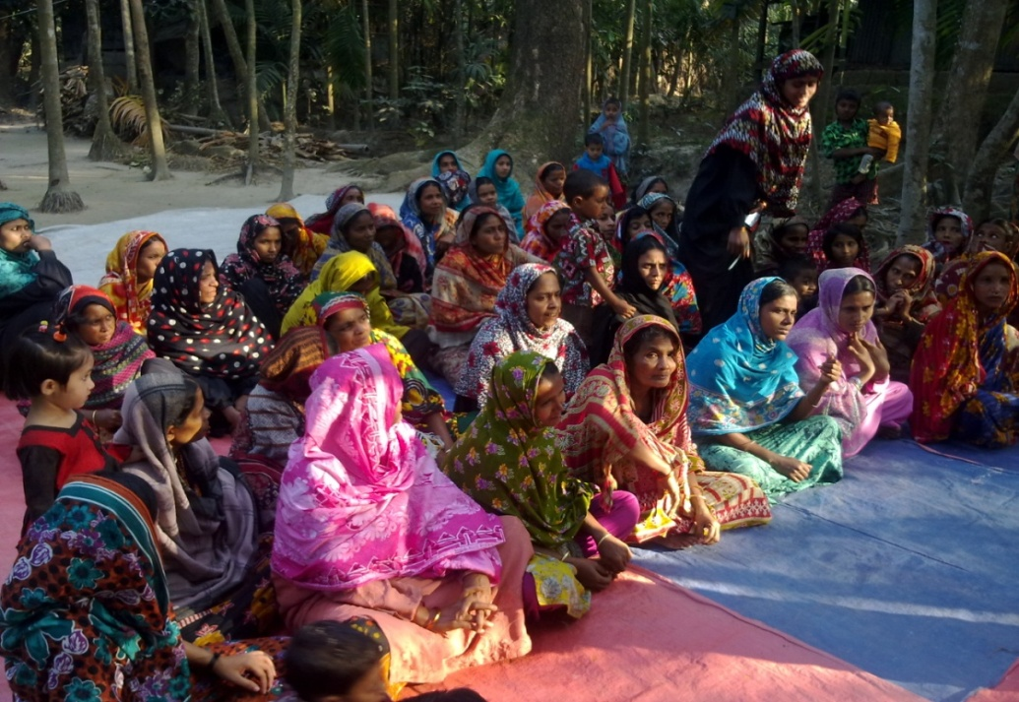
Approach to Capacity Development of
Farmers’ Organizations – Mapping As First Step
FAO-TA-IAPP Update
Purpose: to understand what farmers’ organizations exist, what they are doing and how they are doing it
177,217 FOs found of different size and structure all over the country
4,144 federated organizations
Variety of organizations with different approaches

Slide 7
Mapping Findings Continued
FAO-TA-IAPP Update
Lack of full autonomy/mostly linked to external partners (government, NGOs and INGOs)
Focus on production skills and distribution of inputs, less on developing strong institutions to get the benefits of being organized
Some federation/networking – but not very common
FOs face challenges to be involved in investment programming:
  Not well organized at higher levels (regional, national)
  Don’t understand how to be involved in the processes
  Lack of access to information

Slide 8
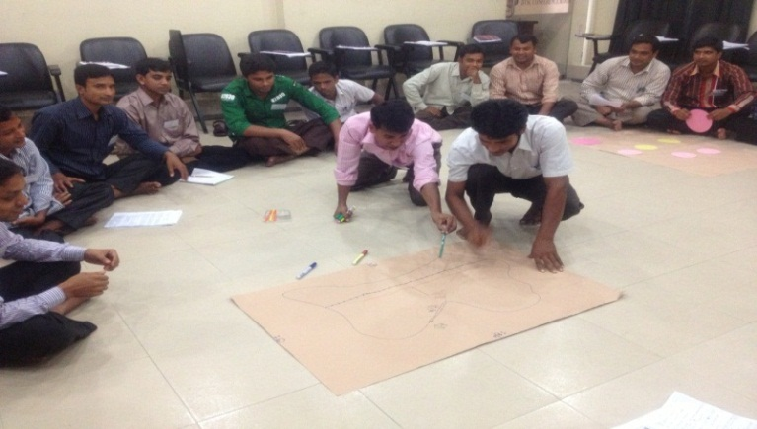
On-going TA to FOs
Begin networking – organized Federated FO sharing workshop
FAO-TA-IAPP Update
Next
Support to capacity development in the future:
  More opportunities for networking
  Trainings
  Study tours abroad
  National exchange visits

Slide 9
FAO-TA-IAPP Update
TA to WB-supervised IAPP components
FAO-TA-IAPP delivered four interventions:
Training of all community facilitators (375) recruited so far by the IAPP;
Coaching and eventual support to drafting the draft operational manual of the IAPP;
A study tour was organized to expose IAPP staff to community mobilization activities undertaken by two WB-financed projects in India; and
Relevant IAPP staff are systematically participating in training events organized by the TA component (in next slide)

Slide 10
FAO-TA-IAPP Update
Three short term training events:
  July 2012: Results Based Monitoring and Evaluation
  September 2012: Good Agricultural Governance
  Early December 2012: COSTAB and financial & economic analysis
  IAPP-TA sent 2-3 carefully selected participants in short courses and events already organized in the region:
      Knowledge management network (Cambodia)
      PCM (Kuala Lampur)
      Seed Congress (Indonesia)
Two PhD on investment planning cycle offered
knowledge management (M&E) networking developed

Slide 11
FAO-TA-IAPP Update
  A result-based Project Cycle Management (PCM) workshop was organized in November 2012 in partnership with the BPATC involving all main stakeholders in technical ministries and agencies, the planning commission, ERD in order to collectively assess the project cycle strengths, bottlenecks and identify potential areas of interventions.
  Training on Ruralinvest (a tool for staff supporting communities to design community investments to access existing funds) for selected staff of multi-agency those works with farming community

Slide 12
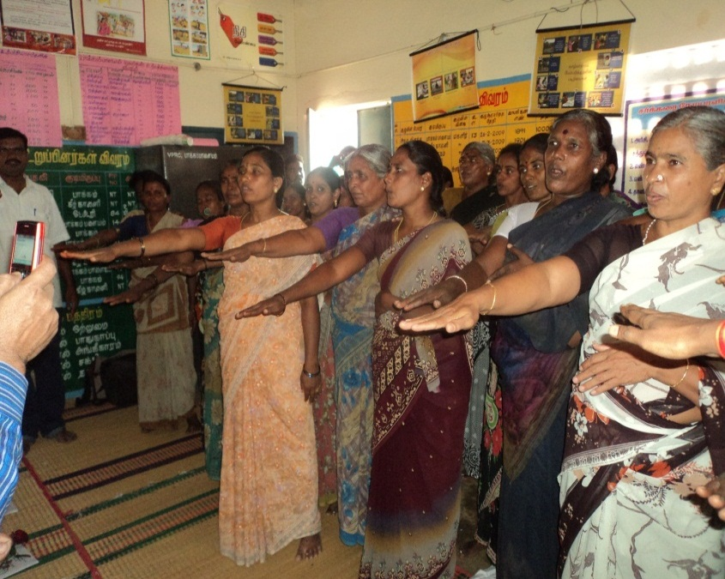
Challenges
Lack of awareness among all stakeholders on importance of participation of FOs in investment program cycle
Lack of institutes and resources (HR) especially for developing capacity in the field of investment programming

Slide 13
Thank you!

